Slide 1
The sims
Sarina Heshmati
sarinaheshmatii@gmail.com
Yasamin Tafakor
yasamintafakor@gmail.com

Slide 2
introduction

Slide 3


Introduction
INTRODUCTION
01 of 24
The Sims
Decision Making
Needs-based-AI

Slide 4
utility

Slide 5
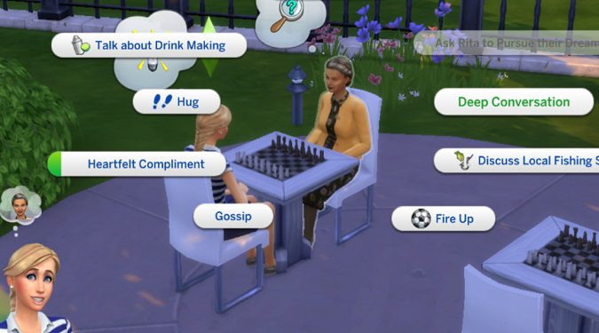
Consistent utility scores
UTILITY
02 of 24
The scale has to be consistent.
The goal is to compare.

Slide 6
Principle of max E-utility
UTILITY
03 of 24
Calculating the weight for each action.
Choosing the best one yet.

Slide 7
Decision factors

Slide 8
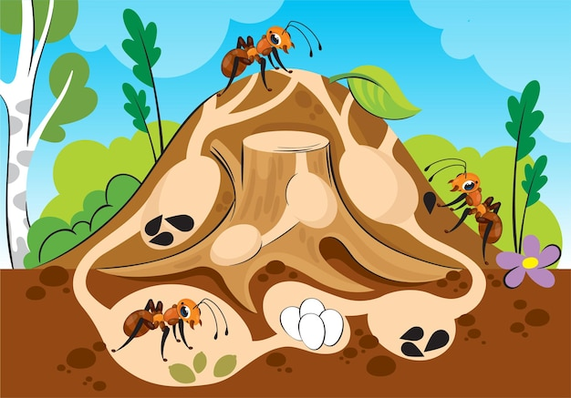
Factors for deciding
DECISION FACTORS
04 of 24
Different aspects are always involved in making decisions.
Expansion vs Breeding
Personality

Slide 9
Calculating utility

Slide 10
Calculating utility
CALCULATING UTILITY
05 of 24
Converting an arbitrary game value into an utility score.
Understanding the relationship between the input and the output is the key.

Slide 11
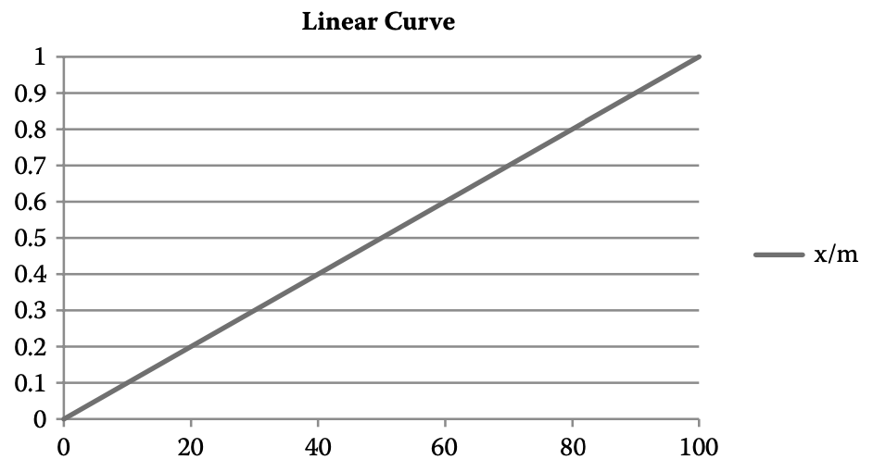
Normalizing: Linear curve
CALCULATING UTILITY
06 of 24

Slide 12
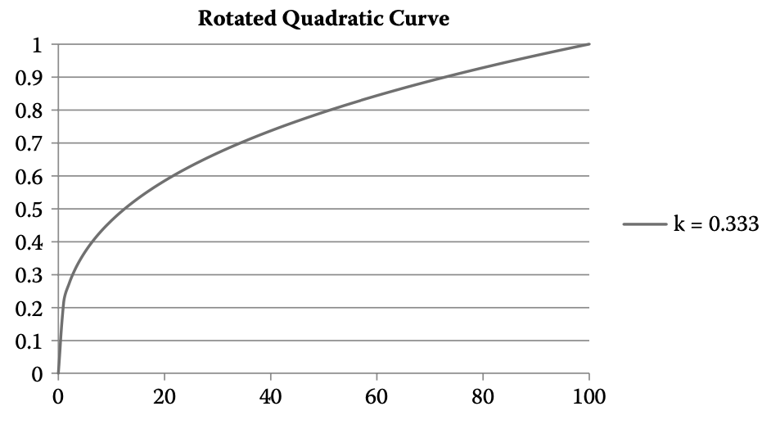
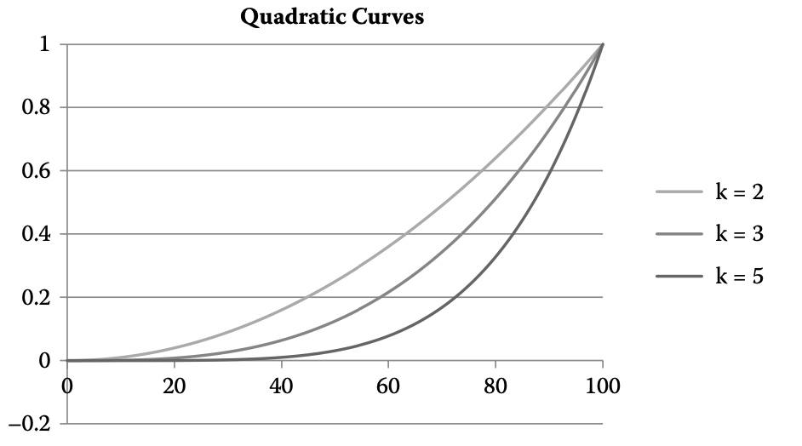
Normalizing: Quadratic & r-quadratic curves
CALCULATING UTILITY
07 of 24

Slide 13
Normalizing: Quadratic & r-quadratic curves
CALCULATING UTILITY
07 of 24

Slide 14
Normalizing: Quadratic & r-quadratic curves
CALCULATING UTILITY
07 of 24

Slide 15
Normalizing: Quadratic & r-quadratic curves
CALCULATING UTILITY
07 of 24

Slide 16
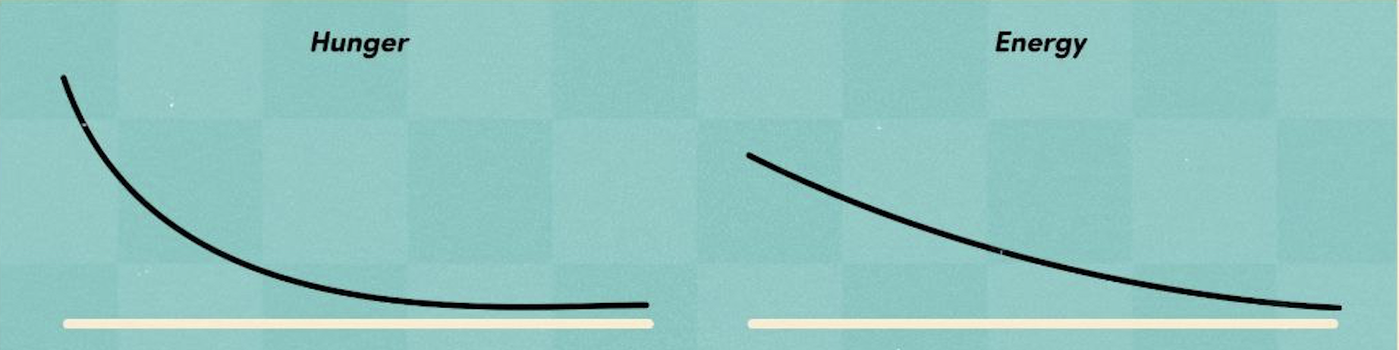
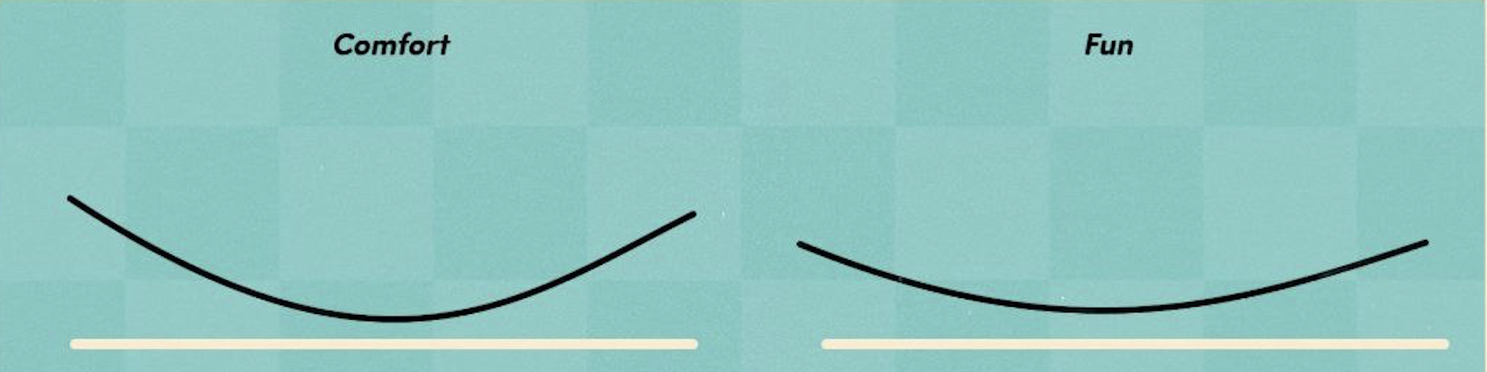

Slide 17
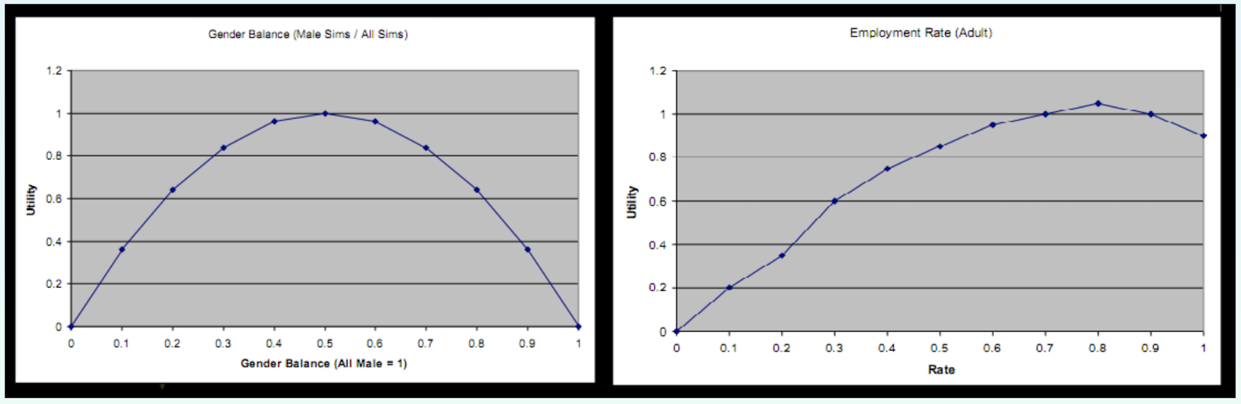

Slide 18
Picking an action

Slide 19
Picking an action
PICKING AN ACTION
08 of 24
The choice must be logical.
Note that the agent must not turn out to be unpleasantly deterministic.

Slide 20
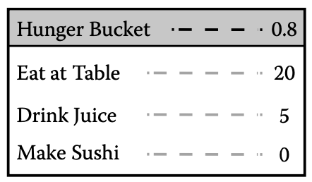
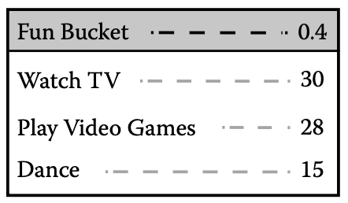
Bucketing technic
PICKING AN ACTION
09 of 24

Slide 21
inertia

Slide 22

Inertia
INERTIA
10 of 24
The issues with oscillation and how to handle them.
Including a hair-splitting weight.

Slide 23
Needs based ai

Slide 24
Ways to drive an artificial agent
NEEDS BASED AI
11 of 24
Finite-state machine
Behavior trees
Needs-based AI

Slide 25
Ways to drive an artificial agent
NEEDS BASED AI
11 of 24
Behavior trees
Needs-based AI
Finite-state machine

Slide 26
Ways to drive an artificial agent
NEEDS BASED AI
11 of 24
Finite-state machine
Needs-based AI
Behavior trees

Slide 27
Ways to drive an artificial agent
NEEDS BASED AI
11 of 24
Finite-state machine
Behavior trees
Needs-based AI

Slide 28
Ways to drive an artificial agent
NEEDS BASED AI
11 of 24
Finite-state machine
Behavior trees
Needs-based AI

Slide 29

Needs based ai
NEEDS BASED AI
11 of 24
Exciting advantage!
AI loop; action selection (actual choice)

Slide 30
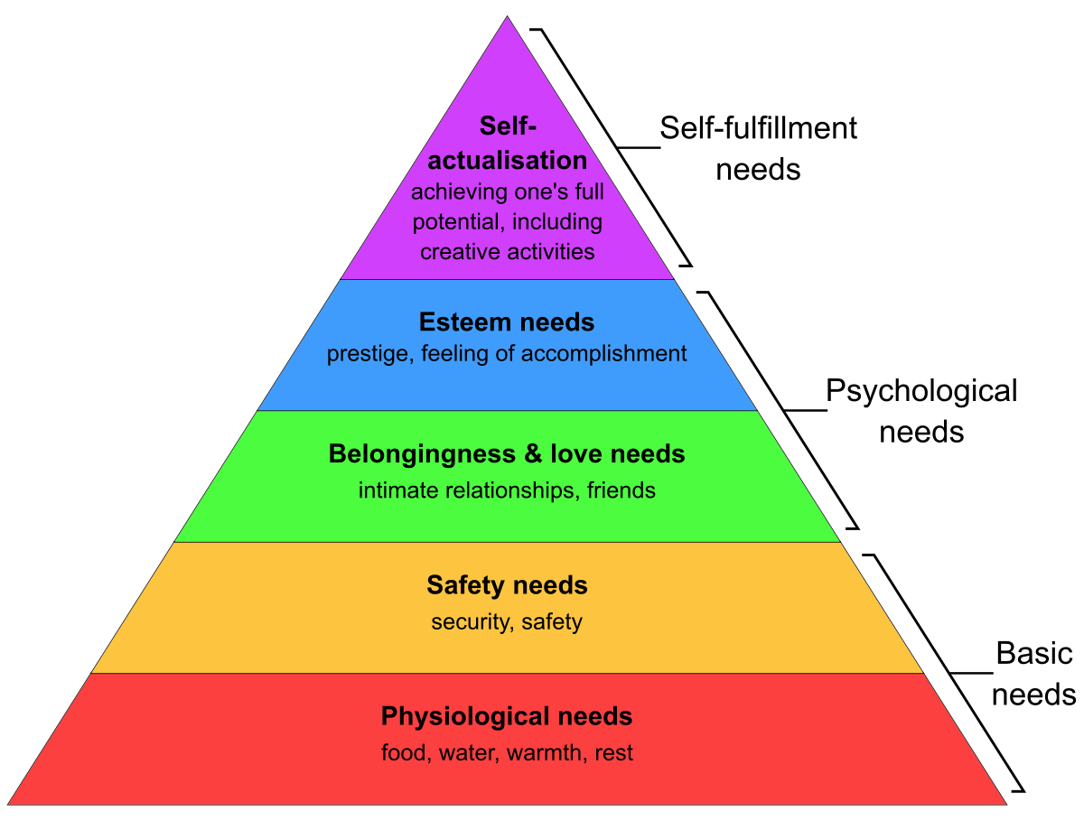
Needs
NEEDS BASED AI
11 of 24
Maslow’s hierarchy (biological & emotional)
Needs are based on the type of game, different game, different needs.
A numerical array, decay overtime.

Slide 31
advertisement

Slide 32
advertisement
ADVERTISEMENT
14 of 24
When the time comes, the agent looks at what can be done in the environment around (asks each object) and evaluates the effect of them.
Each object advertises a tuple.
Great flexibility.

Slide 33

Advertisement scoring
ADVERTISEMENT
15 of 24
trivial
H from 70 to 90 = T from 10 to 30
Attenuated need
30 to 90 = 50 to 90 = 100 to 90!
Attenuated need-delta

Slide 34
Action selection

Slide 35
Action selection
ACTION SELECTION
16 of 24
Winner takes all
Weighted-random

Slide 36
Action selection addition
ACTION SELECTION
17 of 24

Slide 37
ACTION SELECTION
18 of 24
Filtering advertisement before scoring
Tuning need decay
A score based on distance
Tuning advertisement score
Tuning attenuation function

Slide 38
Action performance

Slide 39
Action performance & chaining
ACTION PERFORMANCE
19 of 24
The sequence must not be atomic.
Actions can be interrupted.
Two method for this.

Slide 40
Action chain state saving
ACTION PERFORMANCE
20 of 24
When an action is interrupted, the state must be saved for it to be picked up later.
Separate numeric value on object.

Slide 41
Design consequences

Slide 42
consequences
DESIGN CONSEQUENCES
21 of 24
1.
Internal variable are hidden for the player, Actions must be comprehensible.
2.
Simulation vs scripted scene.
Thought bubbles!
Forcing action on agents queue.

Slide 43
Final words

Slide 44
Final words
FINAL WORDS
22 of 24
Computationally efficient.
System internals are easy to understand.
Easy to reconfigure by simply adding or deleting objects.

Slide 45
refrences
FINAL WORDS
23 of 24
An introduction to utility theory by David “Rez” Graham
Needs-based AI by Robert Zubek

Slide 46
Thanks for your attention.
Contact info:
FINAL WORDS
24 of 24
sarinaheshmatii@gmail.com
yasamintafakor@gmail.com

